Slide 1
Week 9: Stack
WIA1002/ WIB1002/WXES1117 :
Data Structures

Slide 2
Stack
A stack can be viewed as a special type of list, where the elements are accessed, inserted, and deleted only from the end, called the top, of the stack.

Slide 3



Methods in stack
Pop() = removes item on top
Push() = adds item at the top
Peek() = access value
on top

Slide 4
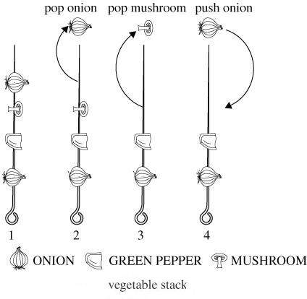

Slide 5
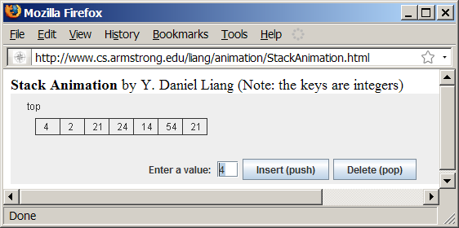
Stack Animation

Slide 6
Check Point
Draw a stack for the following :
Push A
Push B
Push C
Pop C
Pop B
Push D

Slide 7
Implementing Stacks
Using an array list to implement Stack.
Since the insertion and deletion operations on a stack are made only at the end of the stack, using an array list to implement a stack is more efficient than a linked list.

Slide 8
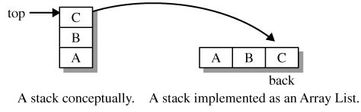
ALStack Class
The Stack interface is an adapter which defines a restricted set of list methods. A Stack class can be implemented using a List class as the storage structure. The ALStack class uses an ArrayList and composition.

Slide 9
MyStack
GenericStack
* The peek() and pop() require that the stack contain at least one element.

Slide 10
MyStack
The peek() and pop() require that the stack contain at least one element.
If condition is not satisfied, the methods should throw an EmptyStackException.
if(isEmpty()) {
throw EmptyStackException();
}

Slide 11
Example: Using Stacks
Example of a program that creates a stack using MyStack.
TestStack
Run

Slide 12
Postfix Expressions
In a postfix evaluation format (RPN) for an arithmetic expression, an operator comes after its operands. Examples:
a + b * c RPN: a b c * + Operator * has higher precedence than +.
(a + b) * c RPN: a b + c * The parenthesis creates subexpression a b +
(a*b + c) / d + e RPN: a b * c + d/ e + The subexpression is a b * c +. Division is the next operator followed by addition.

Slide 13
Postfix Evaluation
To evaluate a postfix expression, execute the following steps until the end of the expression.
If recognize an operand, push it on the stack.
If recognize an operator, pop its operands, apply the operator and push the value on the stack.
Upon conclusion, the value of the postfix expression is on the top of the stack.

Slide 14
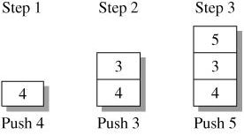

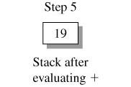
Postfix Evaluation (continued)
Example: evaluate "4 3 5 * +"

Slide 15
Postfix Evaluation
At each step in the postfix evaluation algorithm, the state of the stack allows us to identify whether an error occurs and the cause of the error.

Slide 16
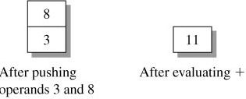
Postfix Evaluation - too many operators
In the expression 3 8 + * 9 the binary operator * is missing a second operand. Identify this error when reading * with the stack containing only one element.

Slide 17
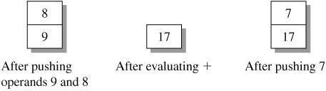
Postfix Evaluation- too many operands
An expression may contain too many operands. Identify this error after processing the entire expression. At the conclusion of the process, the stack contains more than one element. Example: 9 8 + 7

